Slide 1
2021
Effects of P2P Intercity Express on Agriculture Development – Evidence from China
Chunyu Qu
Fordham University

Slide 2
1.Introduction
Why P2P intercity express？
2.Research Questions
How beneficial to farmers?
Supply demand framework
Content
3.Data
Survey
4. Specification
Difference-in-difference
5. Identification
Spillover, attrition

Slide 3
PART ONE
Introduction
01
What is P2P intercity express in China like?

Slide 4
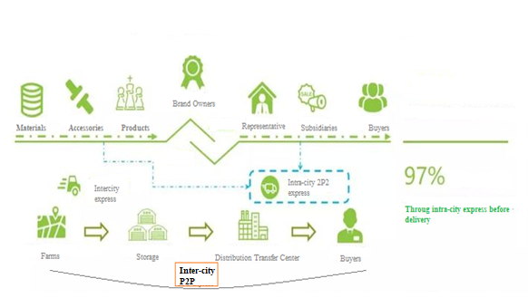
01
Introduction
Please click here to add the required titles
P2P express in China
97% of all the deliveries are through intra-city P2P express
Inter-city delivery still in old model: high expense, high attrition cost.
No inter-city P2P model before 2020 in China

Slide 5
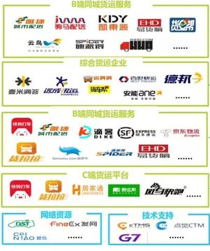
01
Introduction
Please click here to add the required titles
Booming Market of Inter-City P2P Express
The biggest increase in business in 2020
More Choices for Farmers
But still only covers 35.2% so far

Slide 6
PART TWO
Research Questions
02
How beneficial to farmers?
Welfare?

Slide 7
02
Research Questions
Please click here to add the required titles
1
How beneficial to farmers?
Importance of Questions
Improve farmers
China’s poor are mainly concentrated in its rural areas (Stuart 2015). With the rapid development of agricultural e-commerce (Zeng et al., 2016), e-commerce poverty alleviation is becoming a new policy for local governments. Empirical evidence supports the conclusion that e-commerce can increase farmers’ income significantly (Jensen, 2007; Burga and Barreto, 2014; Shimamoto et al., 2015).
Challenges
With the market being more competitive, the poor farmers’ disadvantages in capital investment (Shao, Z., 2017) and human resources (Luo and Niu, 2019) are magnified.
Profits increase and sales increase
2
Supply demand framework
Welfare: consumer surplus and producer surplus

Slide 8
02
Research Questions
Please click here to add the required titles
1
How beneficial to farmers?
Controversial
Positive
E-commerce reduces the middle man expenses in sales channls (Bakos, 1998)
E-platforms make information more efficient (Varian et al., 2004), helping the sellers better use information to optimize production (Baorakis et al., 2002).
E-commerce helps sellers expand their markets (Fraser et al., 2000; Baourakis et al., 2002; Montealegre et al., 2007).
Negative
1. DiMaggio and Hargittai (2001), and Bonfadelli (2002) all insist that new IT will only benefit people with a higher level of education and income.
2. Additional inequality of competition due to e-commerce (Zeng et al., 2018)
Profits increase and sales increase
2
Supply demand framework
Welfare: consumer surplus and producer surplus

Slide 9
PART THREE
Data and Experiment Design
03
From Surveys

Slide 10
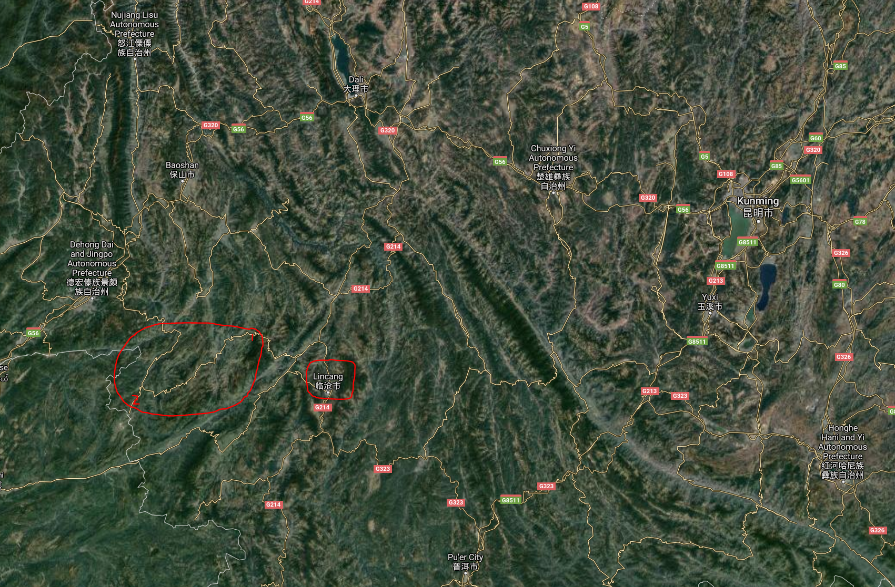

03
Data and Experiment D
China’s new transportation and shipment boom plan
Huolala announced expand business into Yunnan mountain area by 2023
Mengsa town (V1) and Longyang (V2) reply on Lincang (96.8% in V1) – classic inter-city express
1
2

Slide 11
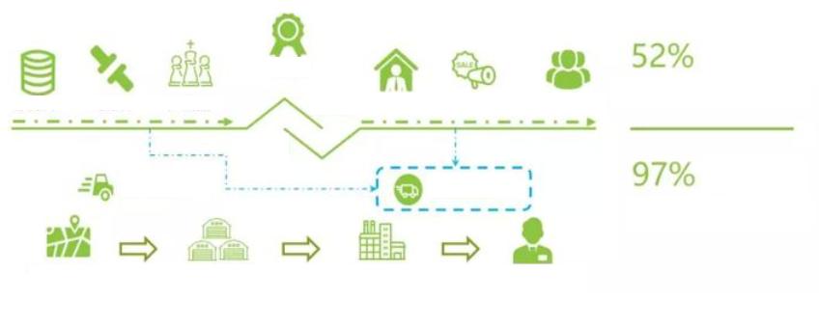
Ship
Brand Owners
Materials Accessories Products Representatives Subsidiary Buyers
Inter-City Ship
P2P Intra-City Exp
Farmers RDC/FDC Storage Transfer Shipment Center Customers
P2P Intra-City Exp

Slide 12
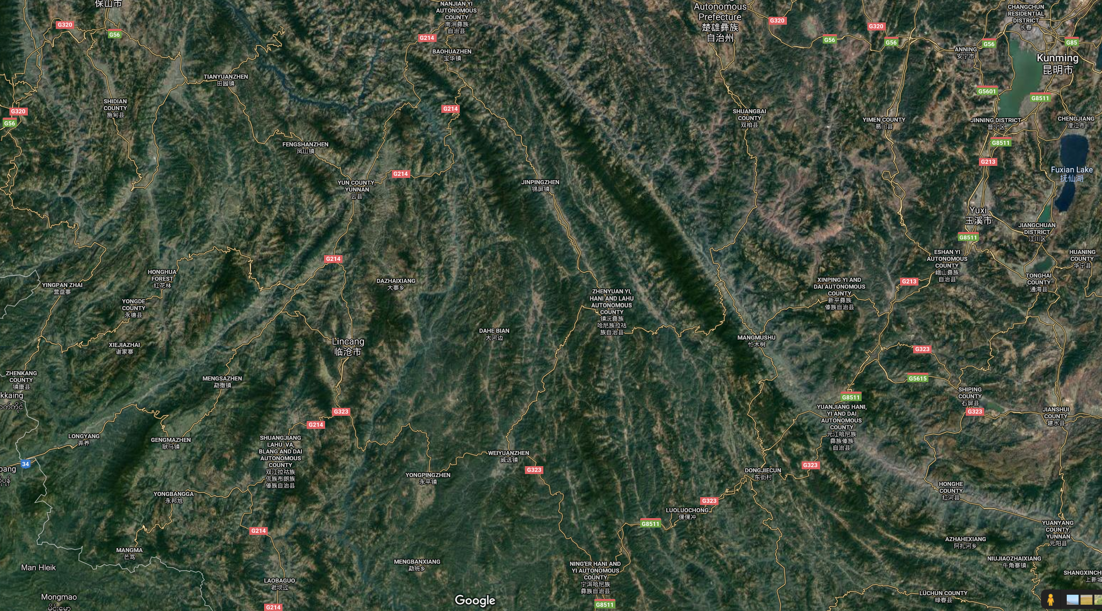
Kunming (Capital)
Lincang City (Governor)
Mengsa V1
Longyan V2
Only Mountain Path
Border

Slide 13
03
Data and Experiment D
Assumptions
A1
A3
No pre-existing differential trends or other factors in market outcomes
across these regions
The timing of service across the regions was nonrandom
A2
A4
Rule out possibility of migration of V2 to V1 in response to the P2P intervention
Market of P2P inter-city express services by platforms are steady overtime

Slide 14
Data and Experiment D
03
Please click here to add the required titles
STEP1
STEP3
Yunan Province
2 villages with barriers extended
No P2P inter-city express
Baseline – Midline – Endline
Random farmers with subsidy
Age & Residence controlled
1
2
3
4
STEP2
STEP4
T0: V1, V2 no express
T1: V1 has express, V2 no
T2: V1, V2 both have
Tea and Rice
Attrition, Spillover

Slide 15
PART FOUR
Econometrics
04
Difference-in-difference with fixed effects

Slide 16
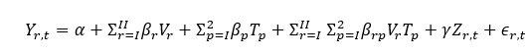
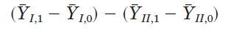
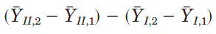
04
Research Questions
Please click here to add the required titles
1
How beneficial to farmers?
Difference-in-difference
Profits and sales data from randomly picked sample of farmers from Village 1 and Village 2, in T0, T1, T2
Y is the value of the outcome of interest in village r in period p. Examine the change V I between periods 0 and 1, i.e., before versus after the introduction of 2P2 intercity express in V I, relative to the change over the same periods for V II
Profits increase and sales increase
Z is a set of control variables
Similarly, for the addition of mobile phone service to region II, we can compare

Slide 17

04
Research Questions
Please click here to add the required titles
Tea and rice
Demand
Overall orders reported on Taobao (Alibaba, cooperated with Huolala) in Lincang and non-Lincang areas
Average dealing prices
Supply
S - Sales
2
Supply demand framework
Welfare: consumer surplus and producer surplus

Slide 18
PART FIVE
Concerns
05
Spillover, attrition

Slide 19
05
Concerns
Please click here to add the required titles
1
Spillover
4
Government Subsidy Effect
From V1 to V2
Attrition
COVID-19 Effect
2
5
Welfare: consumer surplus and producer surplus
3
P2P market
6
Short Term vs Long Term

Slide 20
References
Please click here to add the required titles
Bakos, J. Y., 1998, “The Emerging Role of Electronic Marketplaces on the Internet,” Communications of the ACM, 41(8): 35-42.
Baorakis, G., M. Kourgiantakis, and A. Migdalas, 2002, “The Impact of E-commerce on Agro-food Marketing: The Case of Agricultural Cooperatives, Firms and Consumers in Crete,” British Food Journal, 104(8): 580-590.
Burga, R., and M. E. G. Barreto, 2014, “The Effect of Internet and Cell Phones on Employment and Agricultural Production in Rural Villages in Peru,” Working Paper, Economics Department, Universidad de Piura.
Daum et al, 2021 “Uber for tractors? Opportunities and challenges of digital tools for tractor hire in India and Nigeria”, World Development
Gao, X., Shi, X., Guo, H., Liu, Y., 2020, “To buy or not buy food online: The impact of the COVID-19 epidemic on the adoption of e-commerce in China,” PLoS ONE 15(8): e0237900.
Jensen, R., 2007, “The Digital Provide: Information (Technology), Market Performance, and Welfare in the South Indian Fisheries Sector,” Quarterly Journal of Economics, 122(3): 879-924.
Luo, Xubei; Niu, Chiyu. 2019, “E-Commerce Participation and Household Income Growth in Taobao Villages,” Policy Research Working Paper; No. 8811. World Bank, Washington, DC. © World Bank.

Slide 21
2021
Thank you!

